Slide 1

PROJECT VIVA
SCM PROJECT 2023
Dated: 22nd March 2023
Department of Computer Science and Engineering,
Chitkara University, Punjab
Submitted By: Submitted To:
Group Name : Group 15 Mentor Name: Dr. Harveen Kaur
Roll.no : 2210990554, 2210990555,2210990553 Group: CSE-G25(Y)
Group: CSE-G25(Y)
Semester: 1

Slide 2
Project Details
Group Name | Group 15
Project Title | Hotel Manika Au Berge Management System
Team Leader | Manmeet Kaur
Details of Work division
Member | Contribution
Manmeet Kaur | Designed and coded the project on Hotel Management system
Mann Sharma | Made necessary commits to the project in GitHub
Manav Singh | Innovated the idea of total billing system within the project
2

Slide 3
Hotel
Manika
Auberge

Slide 4

PROJECT INSIGHT
This Project on Hotel Management is a general software developed (using Python) to simplify hotel operations by automating them. In this project, “Hotel Manika Auberge ” is the project’s hotel name. It covers major aspects of hotel management; it could perform the following operations- Hotel Booking, Provide you with Hotel Rooms Info, Room Service, Billing and Record-Keeping.
4

Slide 5
Project Introduction
The first one is the main module which is used to control all the other modules given in the script.
Second one is the “Customer Information” module which displays the data or the information of the customer.
Third one is the “Room Rent” module which displays the type of room is to rent by the customer .
Fourth one is the “Food Purchased” module which displays the list of food items that was ordered by the customer.
Fifth and the last one is the “Hotel Bill” module which is this module displayed the total purchased of the customer.

Slide 6
The Flow of The Project
Home Page
Customer Information
Room Booking
Restaurant module
Food Billing
Payment Record

Slide 7
The Customer Information Module
In this module, we can enter the Customer’s Details given by him/her and store it for further records.
Approach :
We entered the details using variable accessed using self keyword.
Customer module
Full Name
Address
Contact Number
Check in
Check out
7

Slide 8
Room Booking Module
This module displays a vast variety of rooms that customers want to choose along with their specific prices. In here, the customer got a vast variety of rooms along with their price from which he/she will choose their Favorite one.

Slide 9
Room Booking Module
Select 1 for Deluxe Rooms
Select 2 for executive Lounge
Select 3 for Studio Rooms
Select 4 for Business Suite
Room booking Module

Slide 10
Restaurant Module
In this module, Program will display the list of food items and their specific price in the Hotel Restaurant which are accordingly ordered by the customer . And thus would provide the bill of the items specified by the user.

Slide 11
Restaurant Module
Outputting the Total bill including tax
Inputting the choice of food n number of times

Slide 12
Total Bill module
In this module, Program will display the total purchase of the customer.
It will print a perfect bill containing Customer Details, Name of the Customer, Address off the Customer, Check-in date, Check-out date, Room no. , Room rent, Food bill, Sub Total, Additional Charges and at the last Grand Total.

Slide 13
Total Bill Module
TOTAL BILL
Room No. & Price
Food consumed Bill
Customer Details Recorded
Final Bill
Additional Taxes

Slide 14
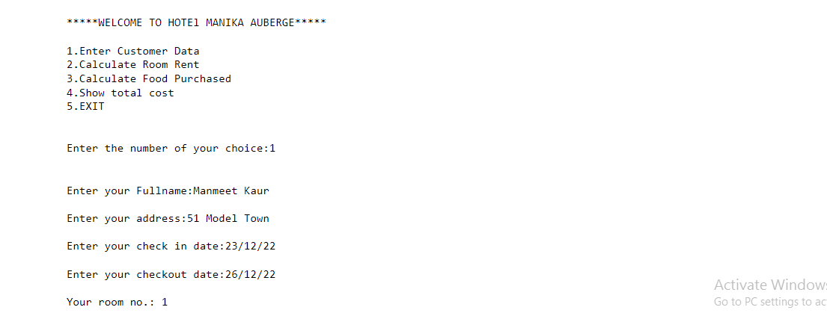
Output snapshots

Slide 15
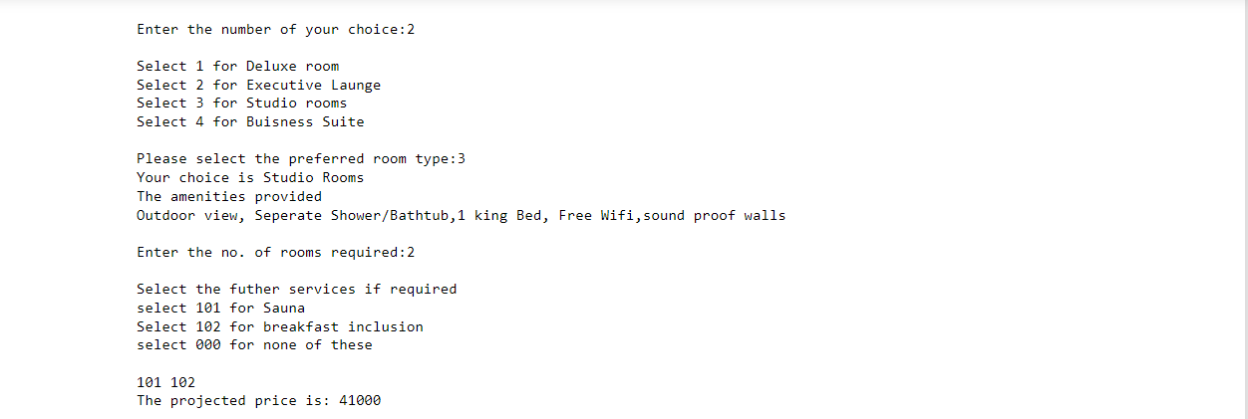

Slide 16
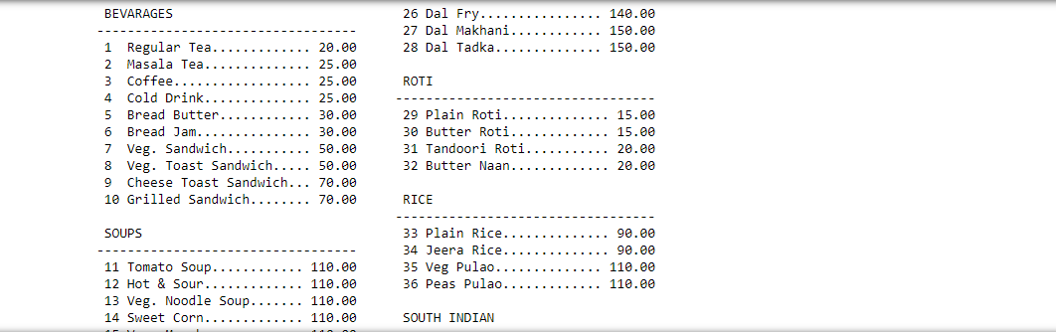

Slide 17
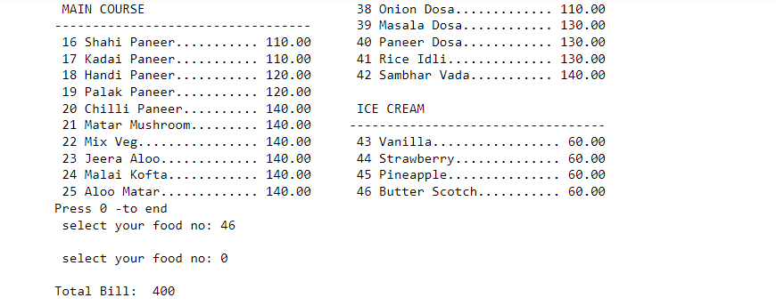

Slide 18
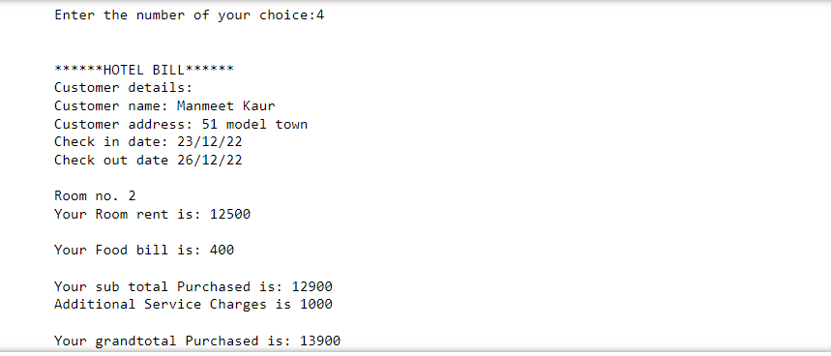

Slide 19
Future Scope & Conclusion
This project is designed to create a platform that allows booth the user and administrator to keep track of transactions like room reservations, room booking, financial administration of the hotel.
Future Scope:
This program can further create a hotel transaction database in excel and access it using various inbuilt functions. Nowadays hotel’s are providing many other facilities, this project can further be improved by adding high level Python modules for intricate details.
19

Slide 20
HOTEL MANIKA AUBERGE MANAGEMENT SYSTEM
A PROJECT BY:
GROUP-15
MANMEET KAUR
2210990554
MANN SHARMA
2210990555
MANAV SINGH
2210990553

Slide 21
THANK YOU
21

